Slide 1
Local Oyster Stock for Restoration:
Does Local Adaptation Affect Outplanting?
Jake Heare, Joth Davis, Brady Blake,
Brent Vadopalas, Steven Roberts

Slide 2
Outline
Why Local Stocks?
O. lurida history
Key Metrics
Expectations
Experiment
Brood/Outplant
Winter Fieldwork
Summer Fieldwork
Results
Mortality
Growth
Reproduction
Conclusion
Summary
Implications
Future Work
Q/A?

Slide 3
Outline
Why Local Stocks?
Experiment
Results
Conclusion

Slide 4
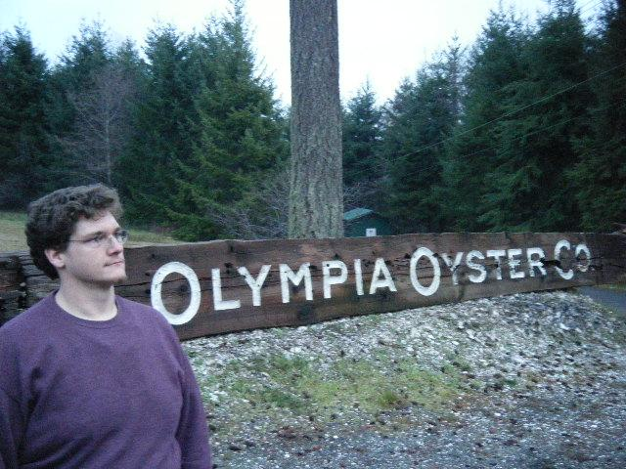
Brief History of Olympia Oysters
Ostrea lurida Native to Puget Sound
Culturally & Commercially Important
Heavy Declines
Model for Restoration

Slide 5
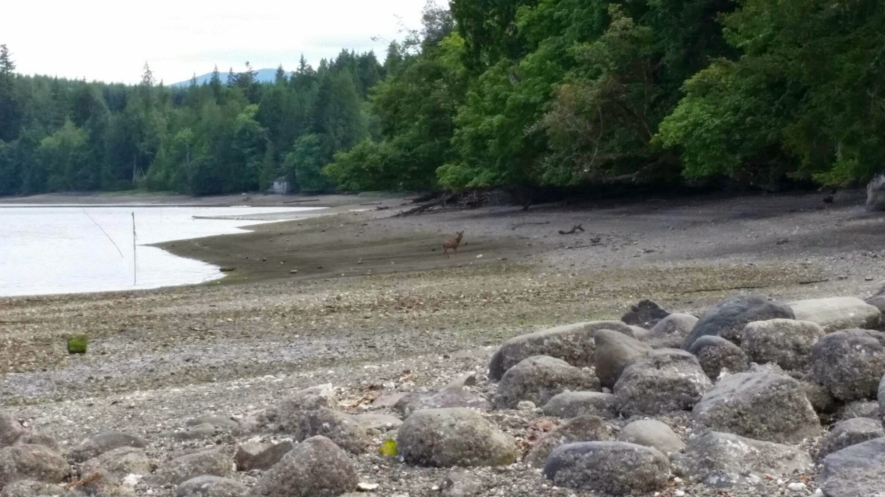
Why Local Stocks May Be Important
Assumed Adaptation
No Scale
Bay or Region?
Ensure Success

Slide 6
Outline
Why Local Stocks?
Experiment
Results
Conclusion

Slide 7
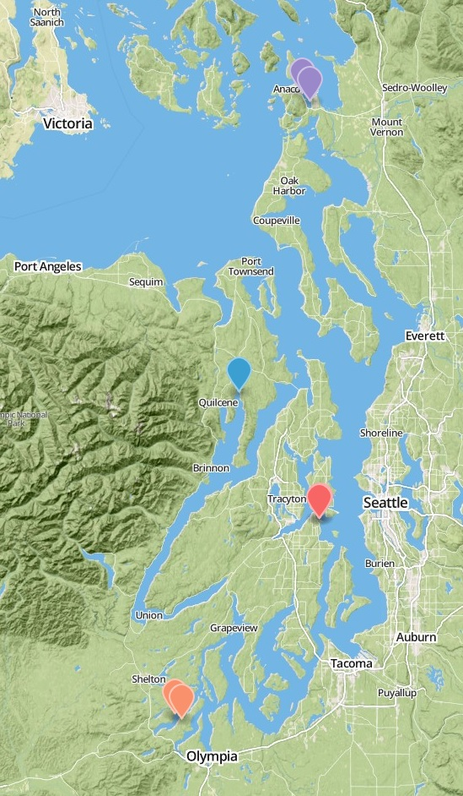
Experiment Basics
Fidalgo Bay
Reciprocal Transplant
Monitor
3 Groups
4 Sites
1 Year
3 Home Sites
1 Foreign Site
Dabob Bay
Manchester
Oyster Bay

Slide 8
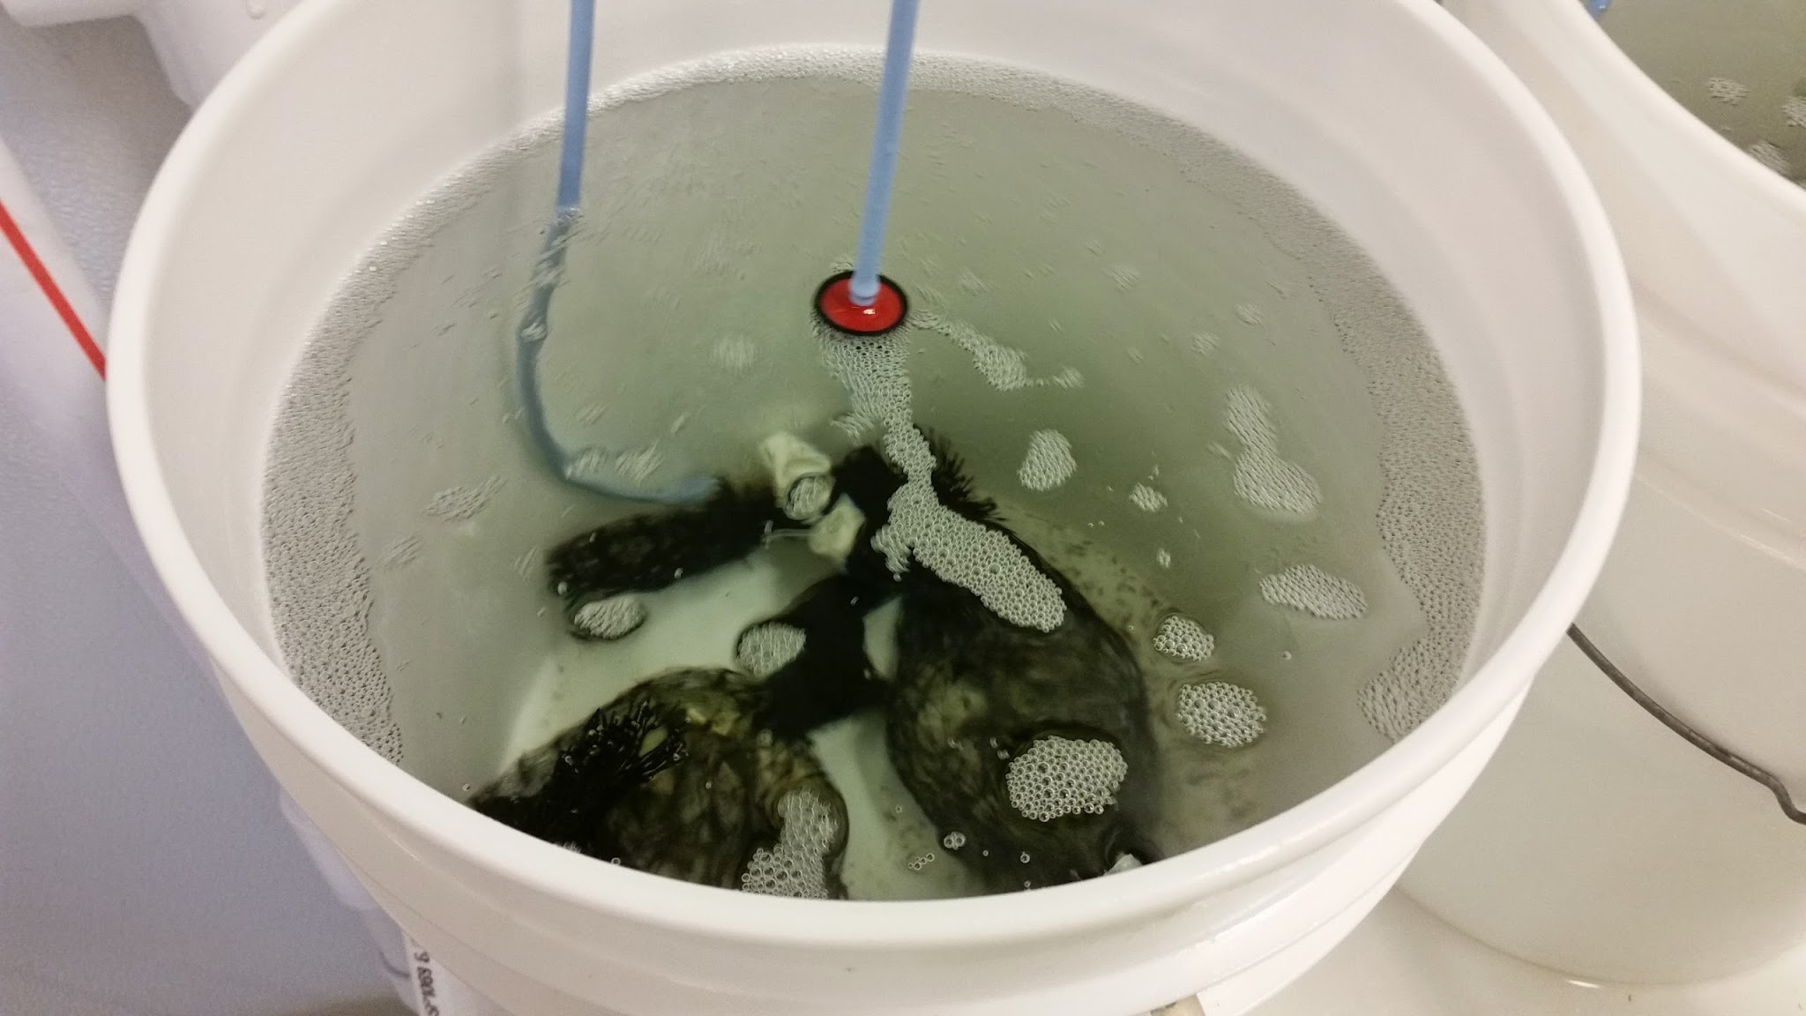
Broodstock and Outplanting
Broodstock
Collected by PSRF
Conditioned at Port Gamble
June 2013
Outplant
Larvae cultured by PSRF
Common Garden Conditions
August 2013

Slide 9
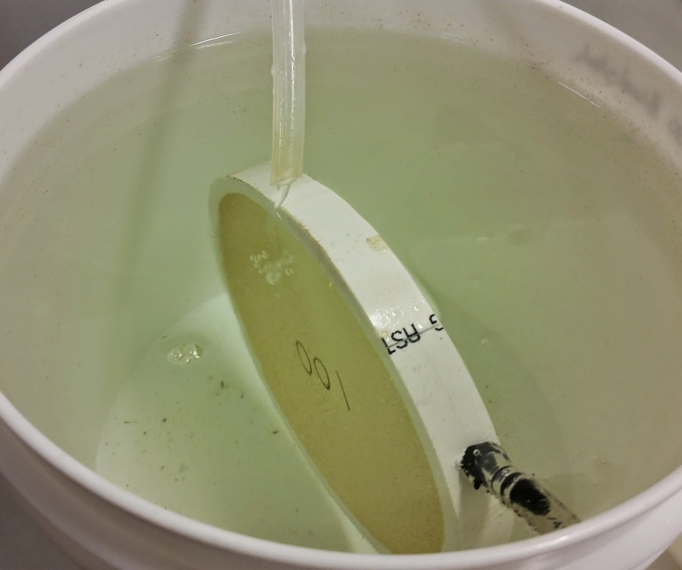
Broodstock and Outplanting
Broodstock
Collected by PSRF
Conditioned at Port Gamble
June 2013
Outplant
Larvae cultured by PSRF
Common Garden Conditions
August 2013

Slide 10
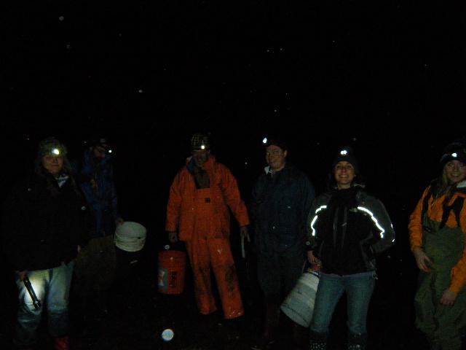
Winter Field Work
Visited 2-4 Months
Collected Dead
Counted Live
Imaged for Size
Maintained Trays

Slide 11
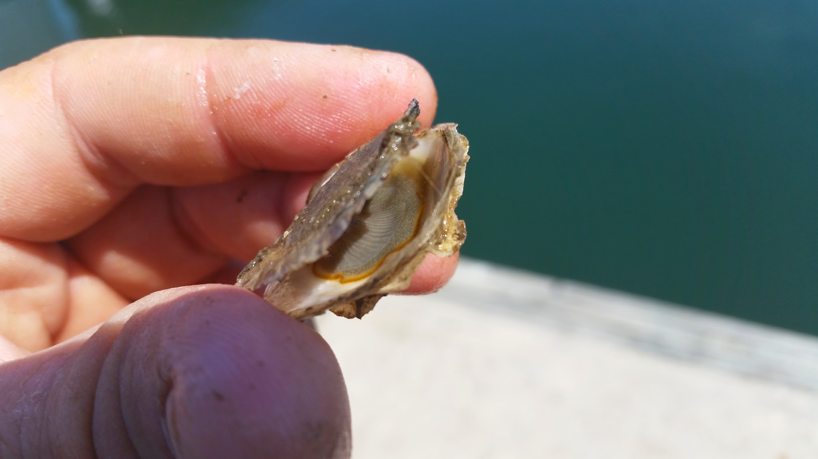
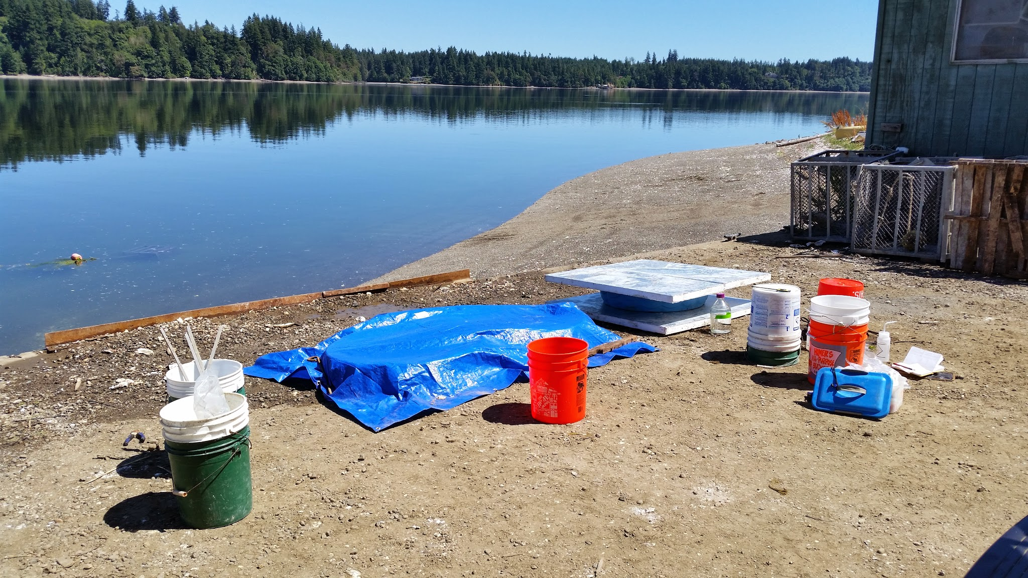
Summer Field Work
15 Weeks
Sampled Brooders
Collected Broods
Hopkins et al. 1936

Slide 12
Key Metrics
What We Want:
Fitness Correlates
Easily Identified
Monitorable
Possible Adaptive Advantage
What We Chose:
Mortality
Growth
Reproduction

Slide 13
Expectations
Equality
Home Field Advantage
Uber-Oyster
???
All Groups Equally Successful
Groups Only Successful at Home
One Group Outperforms
Mixed Results

Slide 14
Outline
Why Local Stocks?
Experiment
Results
Conclusion

Slide 15
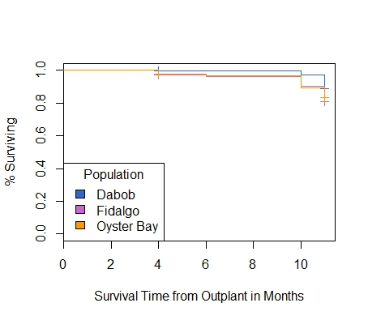
1.0
0.5
0
Aug Oct Dec Feb Apr June
1.0
0.5
0
Mortality
Aug Oct Dec Feb Apr June
Notes:
Make into two slides

Slide 16
1.0
0.5
0
Aug Oct Dec Feb Apr
1.0
0.5
0
Mortality
Aug Oct Dec Feb Apr June
Notes:
Make into two slides

Slide 17
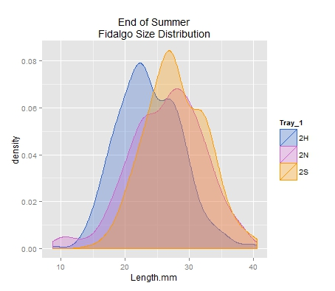
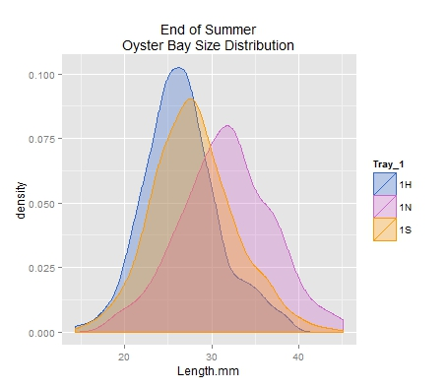
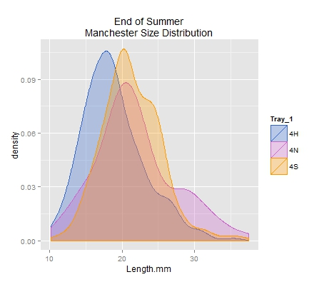
10 20 30 40
Growth
20 30 40
10 20 30

Slide 18
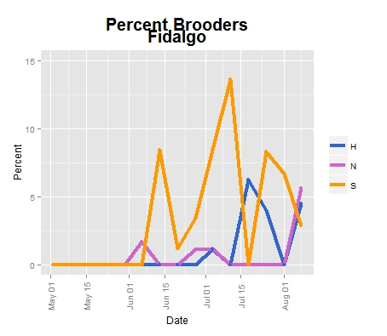
15
10
5
0
May June July Aug
15
10
5
0
15
10
5
0
Reproduction
May June July Aug
May June July Aug

Slide 19
Outline
Why Local Stocks?
Experiment
Results
Conclusion

Slide 20
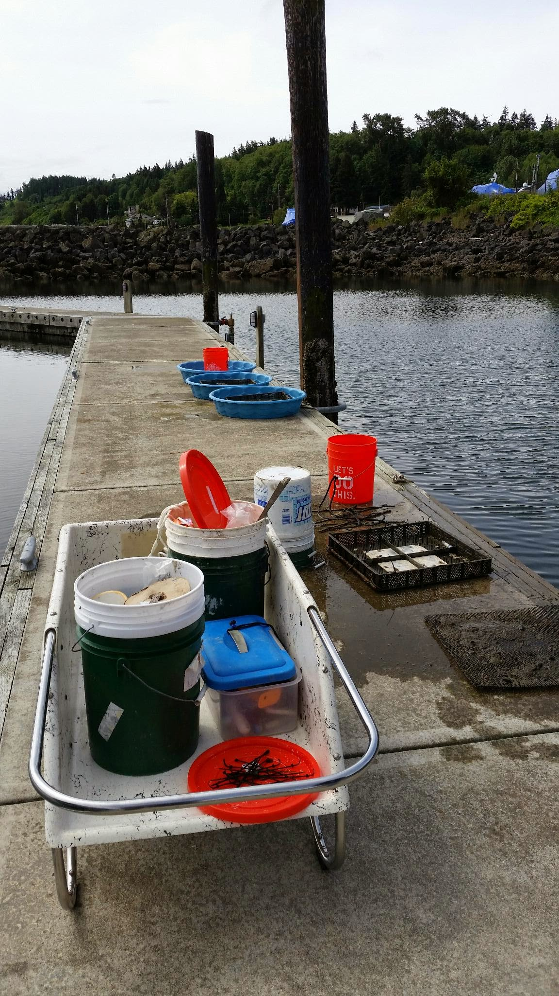
Summary
Mortality
Dabob Survives Extremes
Fidalgo High Mortality in Extremes
Growth
Fidalgo Largest
Dabob Smallest
Reproduction
Oyster Bay Most Active
Dabob Least Active

Slide 21
Expectations Vs. Reality
Equality?
Home Field Advantage?
Uber-Oyster?
???
No
No
No
No Clear Winner/Loser?

Slide 22
Implications
If:
Equality
Homefield Advantage
Uber-Oyster
???
Then:
All Work
Select Based on Site
Easy Choice
Best Guess
Notes:
If, Then statements

Slide 23
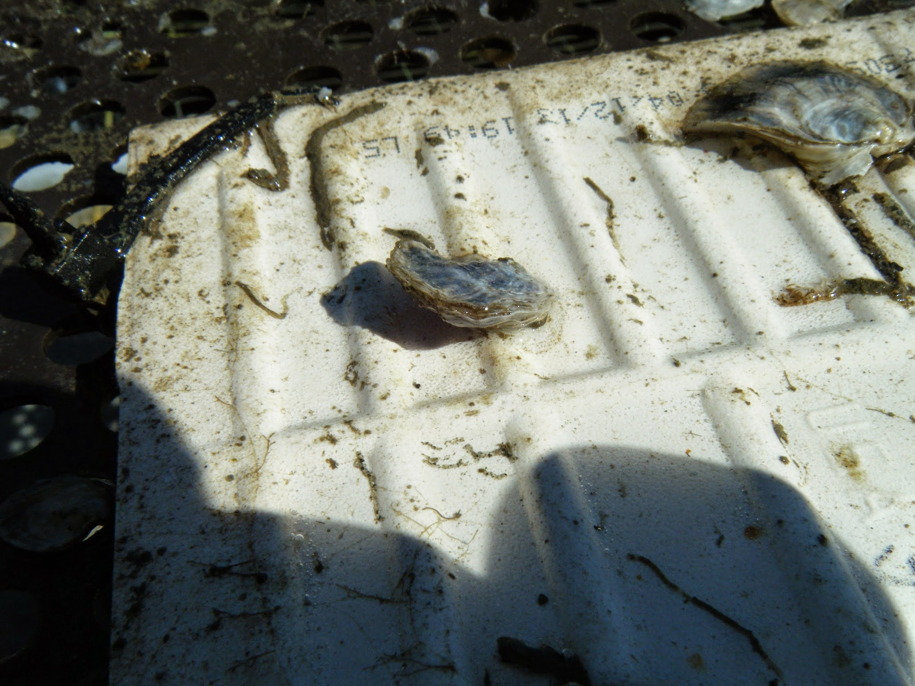
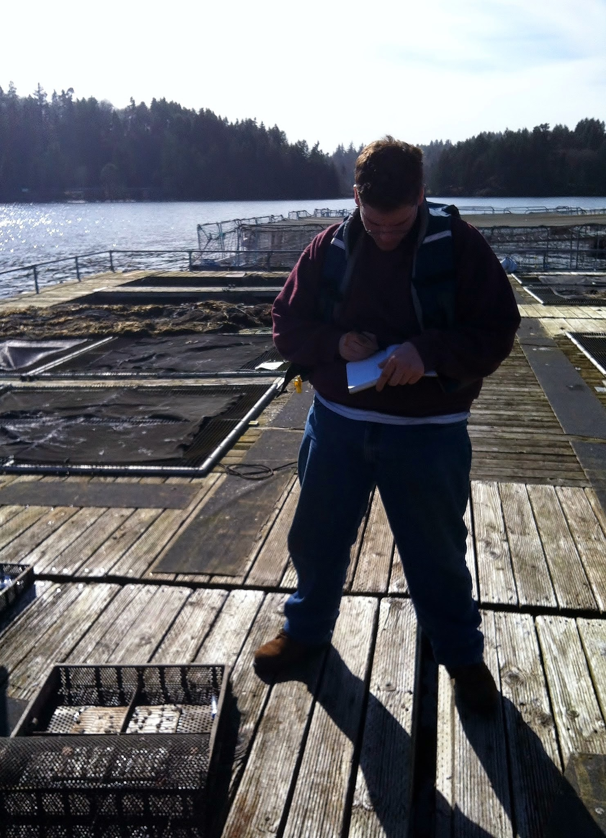
Future Research
Population Genomics
Fecundity

Slide 24
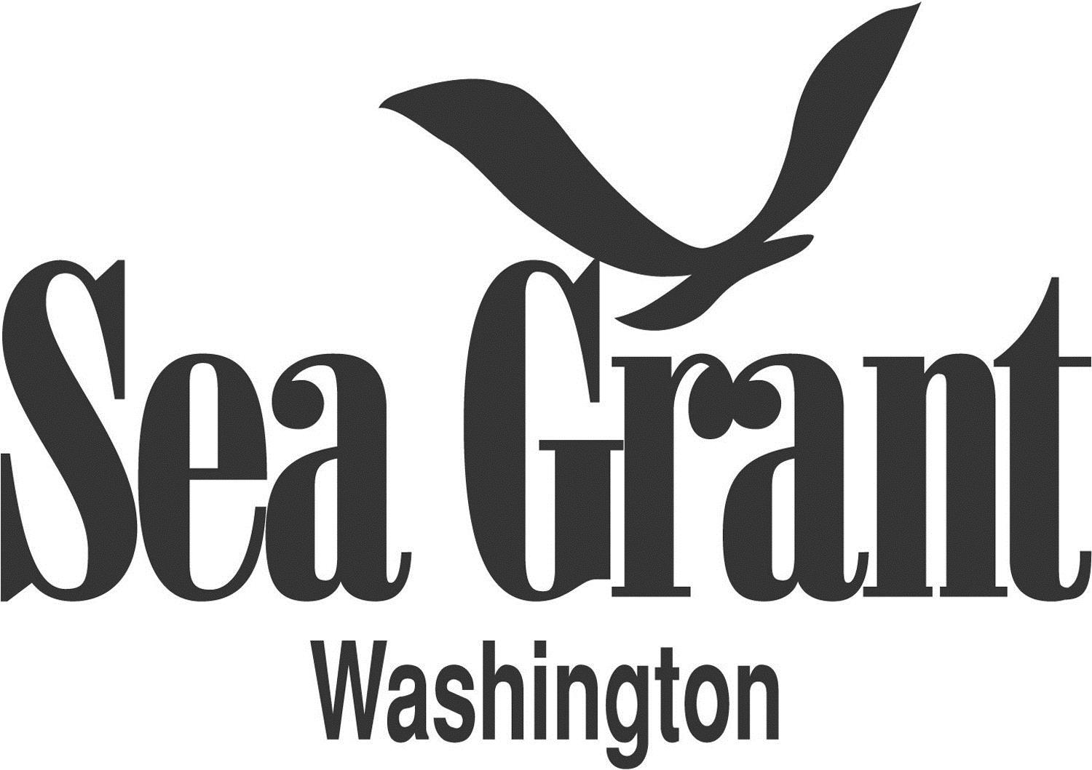
Acknowledgements

Slide 25
Acknowledgements
Roberts Lab:
Sam White
Claire Olson
Mackenzie Gavery
Emma Timmins-Schiffman
Grace Crandall
Jonathon Allen
Etilet Maipi
Samantha Adams
Hannah Wear
Jessica Richards
Katie Jackson
Andy Jasonowicz
Doug Immerman
Giles Goetz
PSRF:
Ryan Crim
Brian Allen
Betsy Peabody
Stuart Ryan
WDFW:
Brady Blake
Crab Fresh:
Brendan Mahaffey
Jeff Koenings
Rick Tweed
Hatchery Crew
Fidalgo Marina:
Einar Sortun
Yacht Owners
Taylor Shellfish:
Molly Jackson
Sara Wykoff
Ed Jones
NOAA:
Rick Goetz
Dive Team
Netpen Crew
Fagergren Family
Rockpoint Oyster Company:
Dick Steele
Crew
Miscellaneous:
L. Christine Savolainen
Sean Bennet
Joelle Blais
Joe Stevick
Bethany Stevick
Lisa Crosson
Alicia Godersky
Lea Savolainen
Photo Credits:
Jake Heare
L. Christine Savolainen
Steven Roberts
Sam Adams

Slide 26
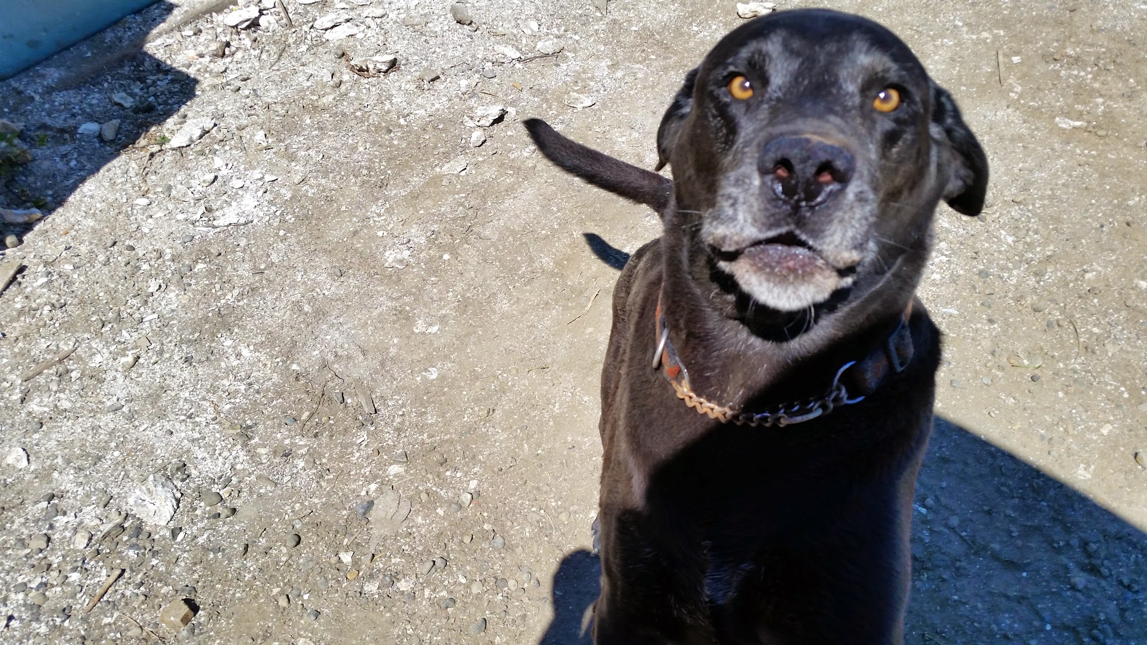
QUESTIONS!
SPECIAL THANKS
TO
JACK
!!!!!!!

